Slide 1
The Bill of Rights

Slide 2
Review: Federalists v. Anti Federalist

Slide 3
Benchmarks:

Slide 6
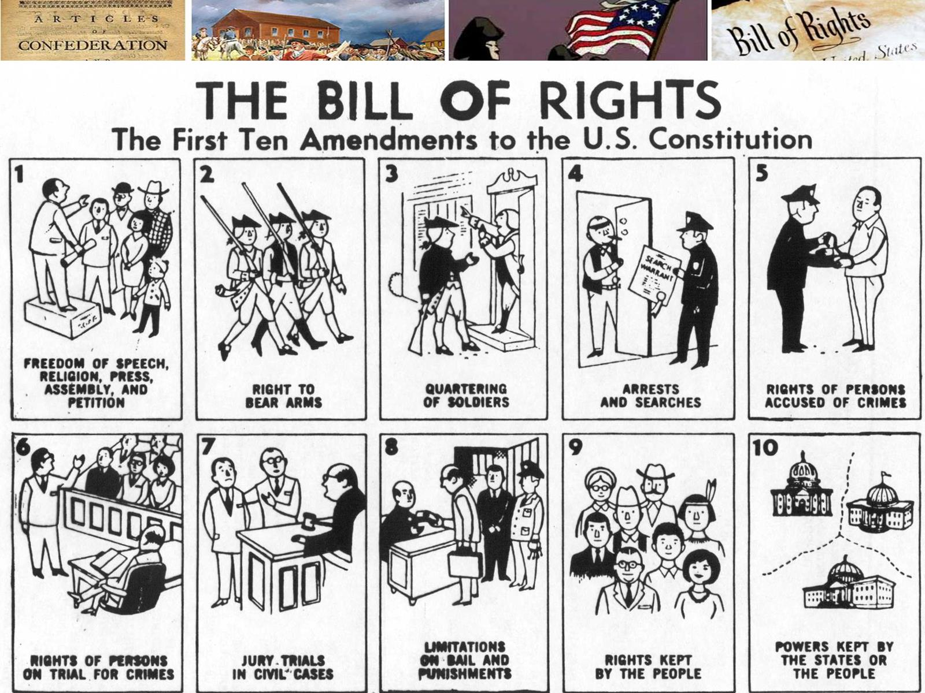

Slide 13
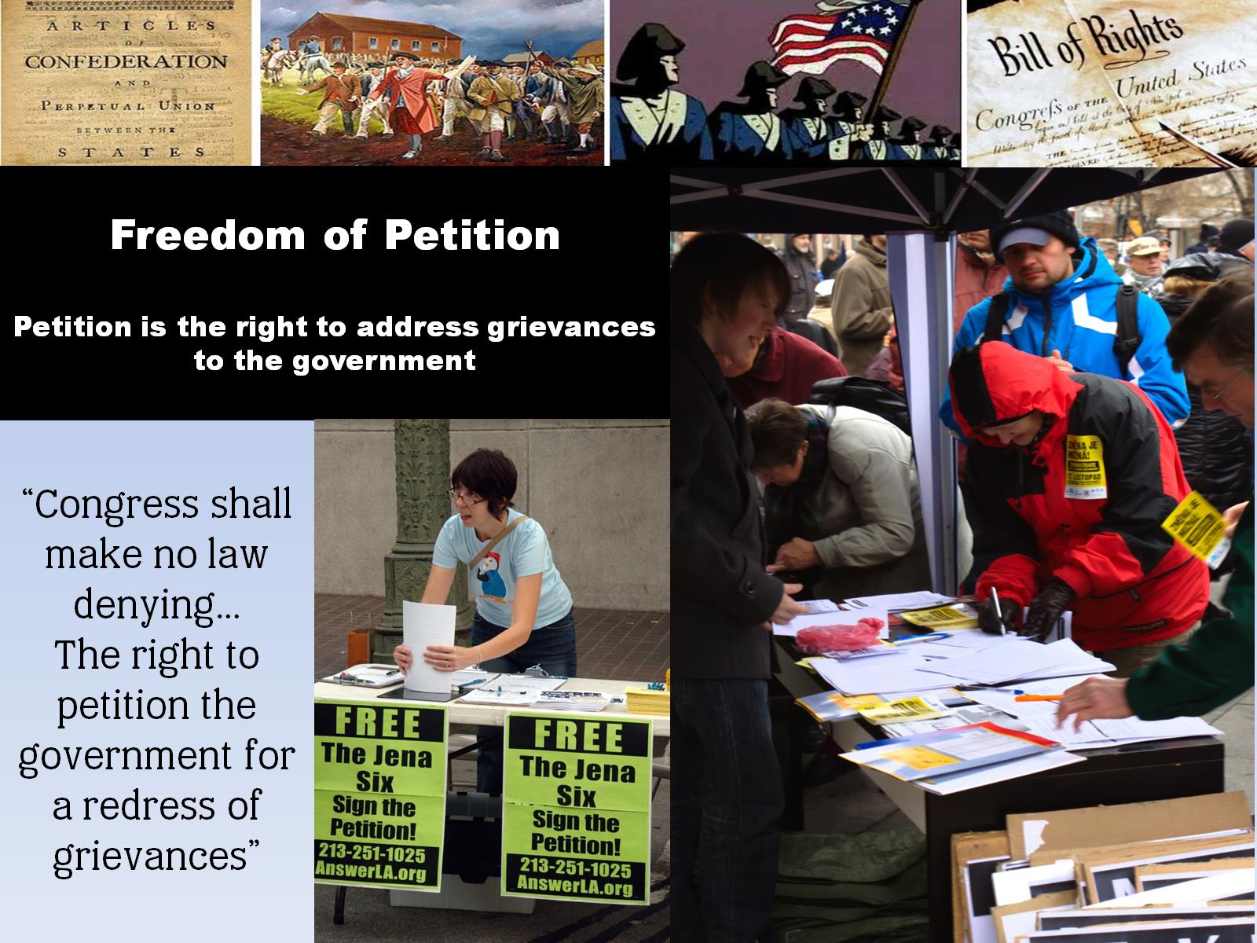

Slide 14
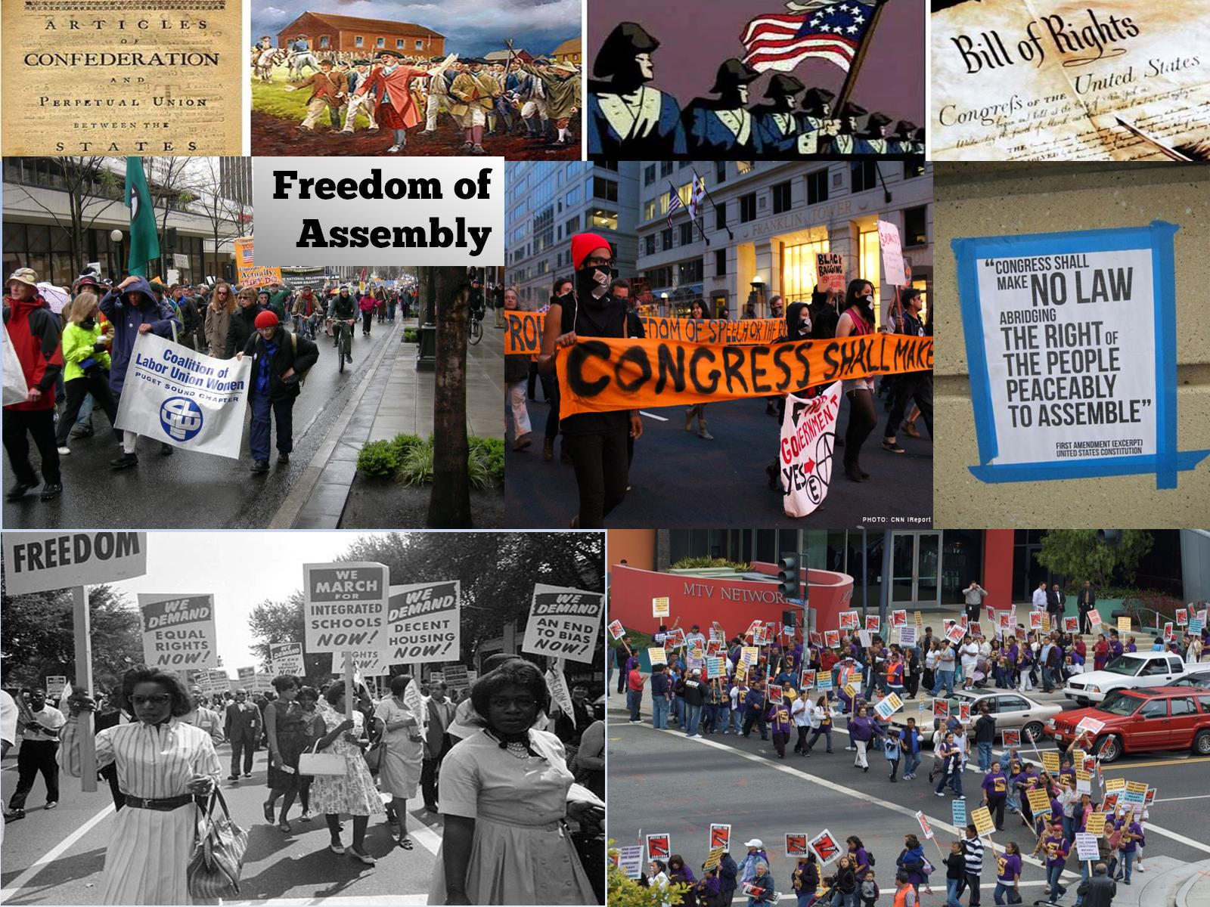

Slide 31
Review: Bill of Rights
Who demanded that the Bill of Rights be added to the Constitution?
The Anti-Federalists

Slide 32
Review: Bill of Rights
Which amendment protects from quartering soldiers?
Amendment III

Slide 33
Review: Bill of Rights
What are the five freedoms from the First Amendment
Speech, press, religion, assembly & petition

Slide 34
Review: Bill of Rights
Which amendment protects from “cruel & unusual punishment”
VIII

Slide 35
Review: Bill of Rights
Which amendment ensures a “speedy trial,” “lawyer,” & “impartial jury”?
VI

Slide 36
Review: Bill of Rights
What do you call when the government takes away someone’s property for public use?
Eminent domain

Slide 37
Review: Bill of Rights
Which amendment protects from unreasonable “search & seizure”?
IV

Slide 38
Review: Bill of Rights
Which amendment states that rights not listed belong to the people?
IX

Slide 39
Review: Bill of Rights
What is it called that you cannot be charged with the same crime twice?
Double Jeopardy

Slide 40
Review: Bill of Rights
What is it called when you do not have to testify against yourself?
“Self-Incrimination”

Slide 41
Review: Bill of Rights
Which amendment protects the right to own firearms?
II

Slide 42
Review: Bill of Rights
Which amendment protects due process rights to a “grand jury,” “no double jeopardy,” and
“self-incrimination”?
V

